Slide 1
Project 1 Exoplanet Data Exploration
Johnny Kushan, Frank Hegedus, Brendan Kirsh, Alyssa Whalen
Credit: NASA

Slide 2
Motivations
Study exoplanet detection methods with varying levels of success
Better understand detection limits
Examine bias in detection of exoplanets
Questions:
What are the limits and strengths of different methods?
Could we detect a planet from our solar system?

Slide 3
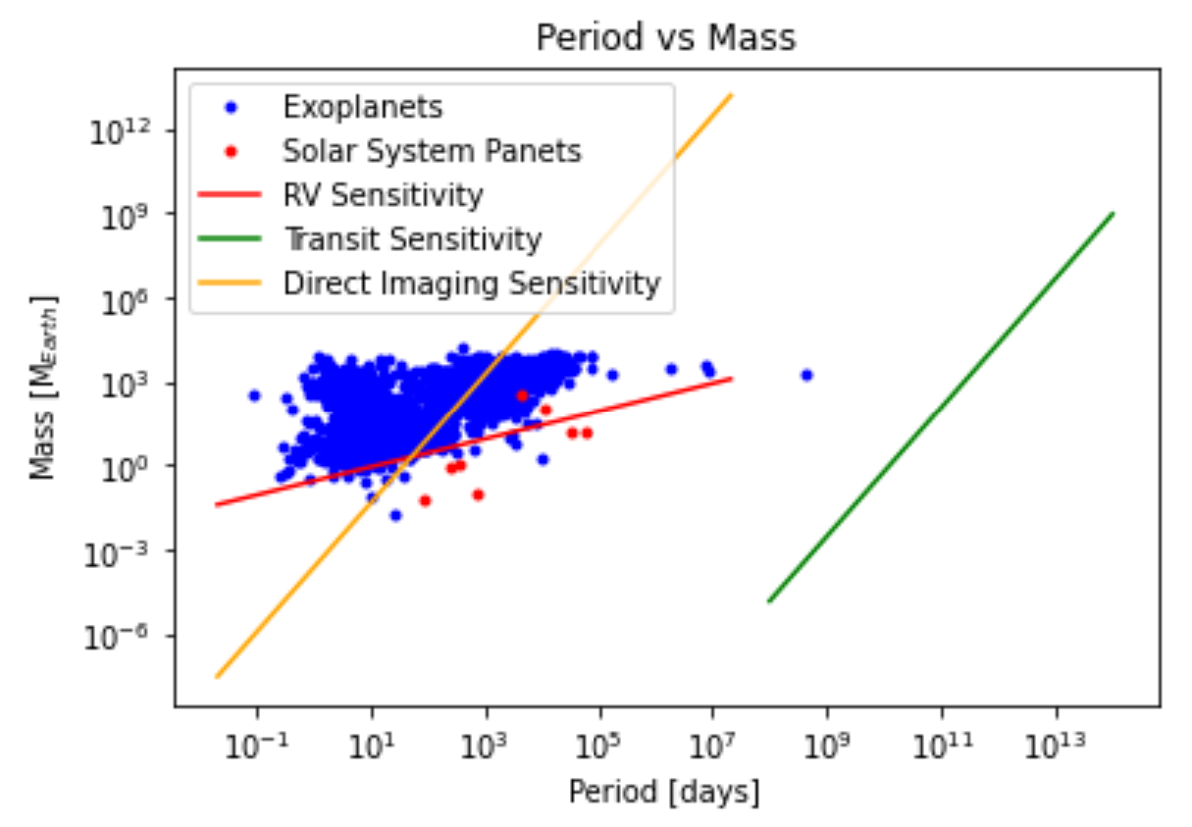
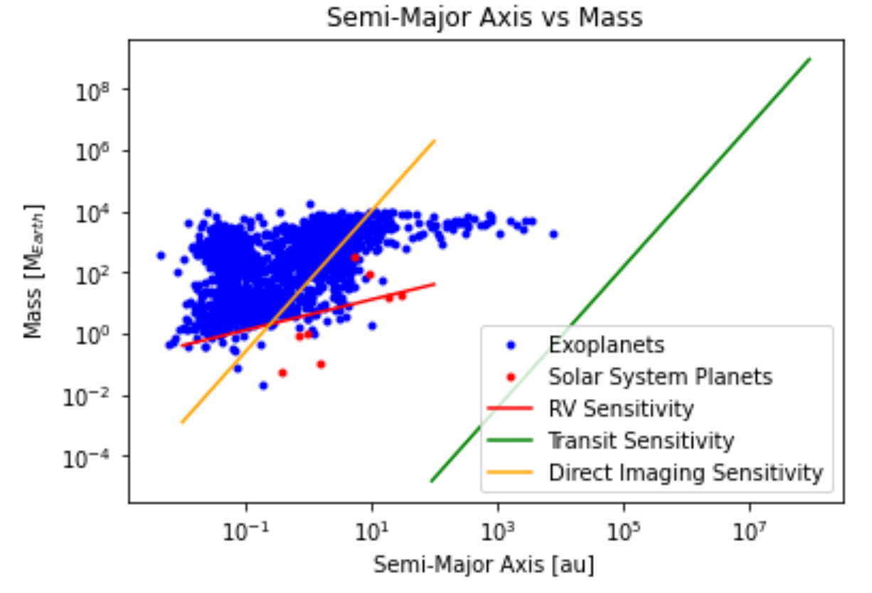
Methods
Distributions of exoplanets
Sensitivity limits
Download data from NASA Exoplanet Archive
Period vs. Mass
Semi-Major Axis vs. Mass
Compare sensitivity to planet distribution

Slide 4
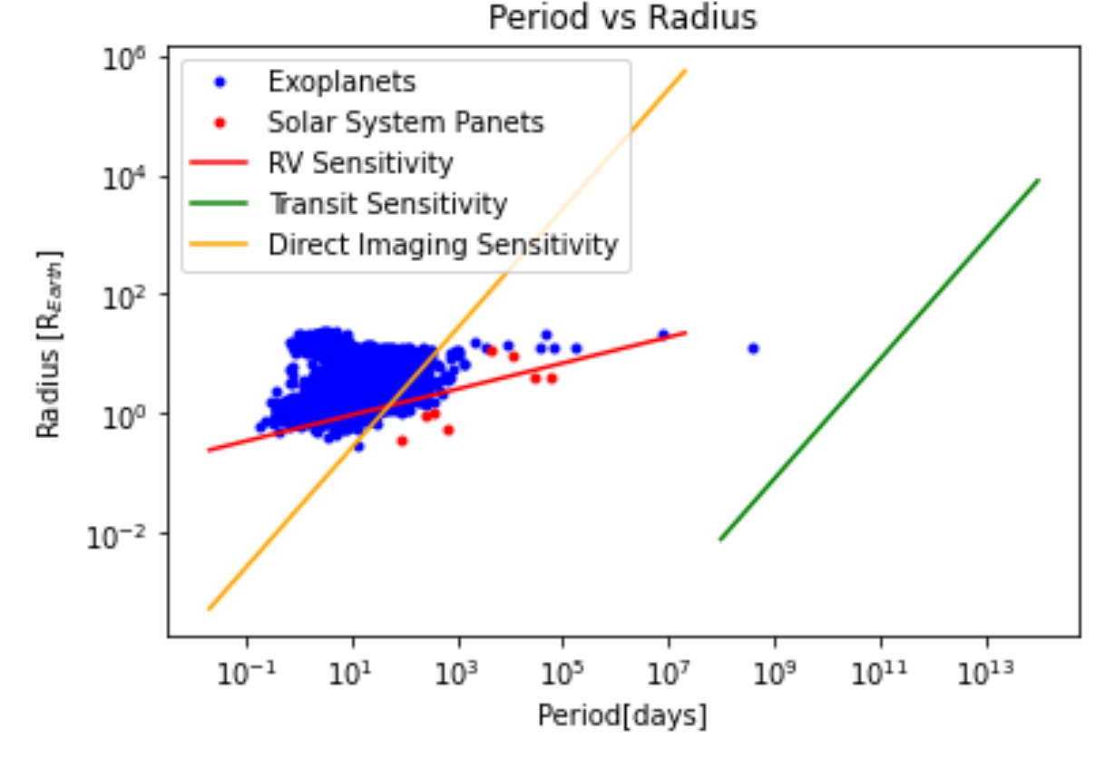
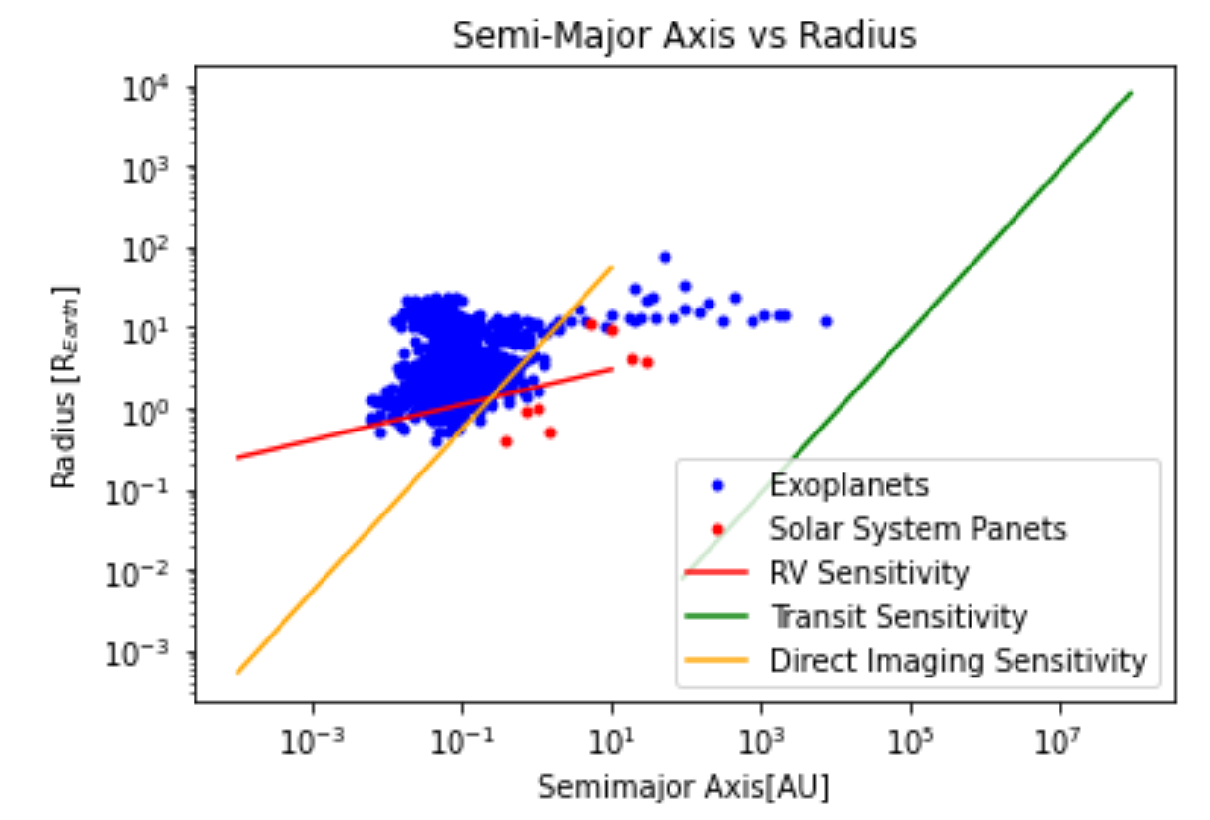
Period vs. Radius
Semi-Major Axis vs. Radius
Solar System is overplotted

Slide 5
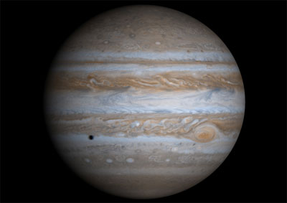
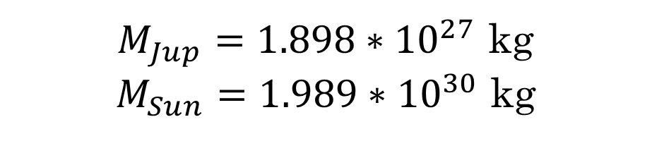
Test Case
$M_{Jup}=1.898∗{10}^{27}$ kg
$M_{Sun}=1.989∗{10}^{30}$ kg
Calculate detected signal from representative case
Compare to state-of-the-art performance
Transit, radial velocity, and direct imaging signal for Jupiter-like planet around Sun-like star
Credits: NASA/JPL/University of Arizona

Slide 6
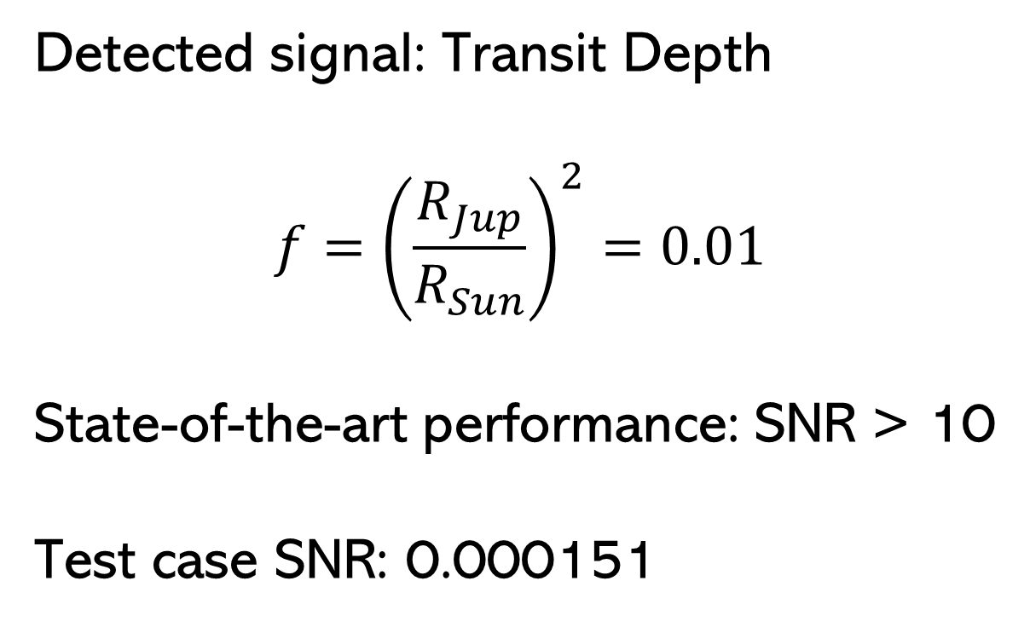
Results: Transit Method
Detected signal: Transit Depth
$$f={\left(\frac{R_{Jup}}{R_{Sun}}\right)}^{2}=0.01$$
State-of-the-art performance: SNR > 10
Test case SNR: 0.000151

Slide 7

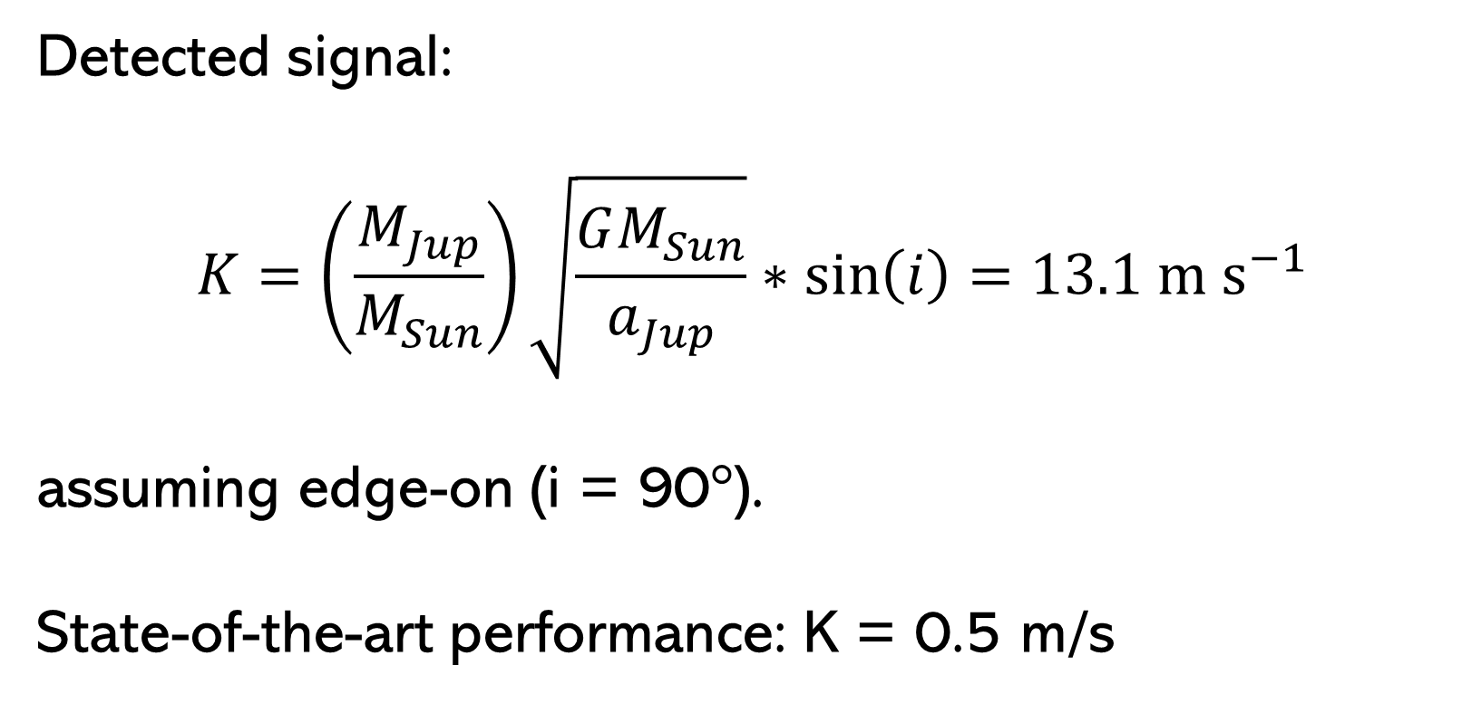
Results: Radial Velocity Method
Detected signal:
$$K=\left(\frac{M_{Jup}}{M_{Sun}}\right)\sqrt{\frac{GM_{Sun}}{a_{Jup}}}∗\sin\left(i\right)=13.1 \text{m} {\text{s}}^{−1}$$
assuming edge-on (i = 90°).
State-of-the-art performance: K = 0.5 m/s

Slide 8
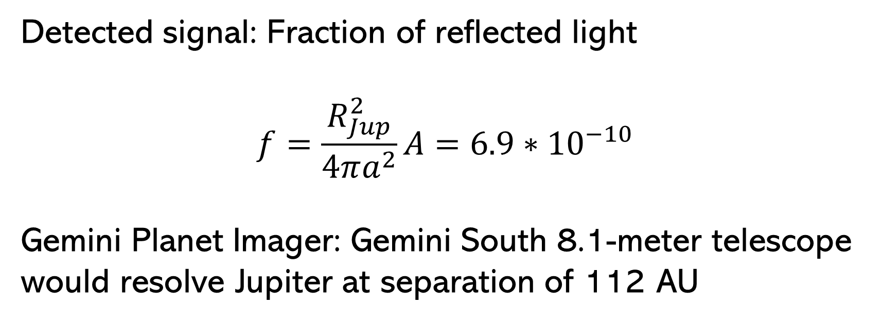
Results: Direct Imaging Method
Detected signal: Fraction of reflected light
$$f=\frac{R_{Jup}^{2}}{4πa^{2}}A=6.9∗{10}^{−10}$$
Gemini Planet Imager: Gemini South 8.1-meter telescope
would resolve Jupiter at separation of 112 AU

Slide 9
Conclusions
Plots inform us about the efficacy of different methods
Example: transit more likely to detect planets that are closer to star
Test case: Jupiter undetected by transit method
Bias: most transit-detected planets have short orbital periods
Jupiter might be difficult to detect

Slide 10
Contributions
Brendan Kirsh: presentation
Frank Hegedus: paper
Alyssa Whalen: signal calculations
John Kushan: coding/data explorer
Questions?

